Slide 1







OpenTransit Bus
Sahil More(MT23078)
Sonik Sarungale (MT23098)
Yashwant Rana (MT23107)

Slide 2

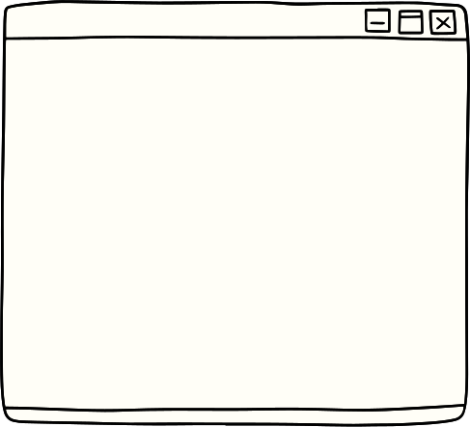



Introduction
In the bustling metropolis of Delhi, efficient public transportation is paramount for its residents. Our solution, the Open Transit Bus application, seamlessly integrates real-time data from OpenTransitDelhi with the power of Google Maps API to revolutionize urban transit experiences.

Slide 3

Features
Real-Time Bus Tracking:
Utilizing OpenTransitDelhi data, our application provides real-time updates on the current location of buses. Passengers can accurately track the movement of buses, reducing wait times and enhancing travel planning.
Dynamic Map Interface:
Leveraging the Google Maps API, our application offers an intuitive and interactive map interface. Users can visualize bus routes, nearby bus stops, and their own location, simplifying navigation within the city.

Slide 4
Features
Location-Based Services:
3. By integrating GPS functionality, our application identifies the user's current location and calculates the nearest bus stop. This feature ensures convenience and efficiency, enabling users to quickly access public transportation options.
In-Bus Navigation:
4.For passengers on board, our application displays all upcoming stops for the selected bus route. This feature enhances situational awareness and helps passengers plan their journey effectively.

Slide 5


Additional Functionaility
1. Coroutines: Open Transit's coroutines ensure smooth multitasking, boosting performance for faster data processing.
2. Geolocation: Accurate tracking in real-time enables personalized navigation, helping users locate nearby bus stops effortlessly.
3. Live API Calls: Real-time updates on bus locations and schedules keep users informed and reduce wait times.
4. JSON Parsing: Efficient extraction of data from APIs ensures quick access to relevant information, enhancing the user experience.
5.Google Maps Integration: Seamless integration with Google Maps offers an intuitive mapping interface for easy route visualization and planning.

Slide 6
Working
Open Transit operates by seamlessly integrating various APIs to provide users with real-time information on public transportation networks. Here's how it works:
1. Geolocation API Integration: Open Transit starts by utilizing the Geolocation API to accurately determine the user's current location. This feature allows the application to provide personalized assistance based on the user's position within the city.
2. Google Maps API Integration: Once the user's location is established, Open Transit interfaces with the Google Maps API to visually display the user's position on a dynamic map interface. This integration enhances spatial awareness and simplifies route planning by showing nearby bus stops and ongoing bus routes.

Slide 7
Working
3.DelhiOpenTransit API Integration: Open Transit further enhances its functionality by integrating with the DelhiOpenTransit API. This API serves as a comprehensive repository of real-time data on bus locations, routes, and nearest stops within the Delhi metropolitan area.
4. Data Processing and Analysis: Upon fetching data from the APIs, Open Transit employs sophisticated algorithms to compute the distance between the user's location and available bus stops. This analysis enables the application to provide users with relevant and actionable insights for their transit options.
5. User Interface and Experience: Throughout the process, Open Transit prioritizes user-centric design principles to ensure a seamless and intuitive experience. The application presents users with clear and concise information, empowering them to make informed decisions about their commuting routes.

Slide 8
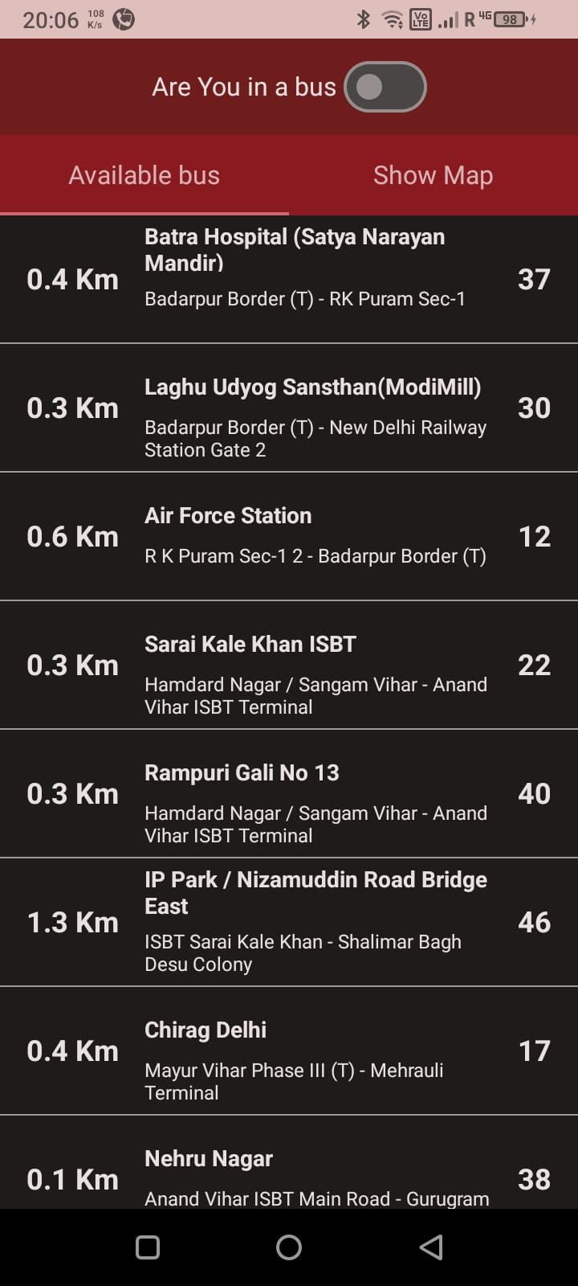
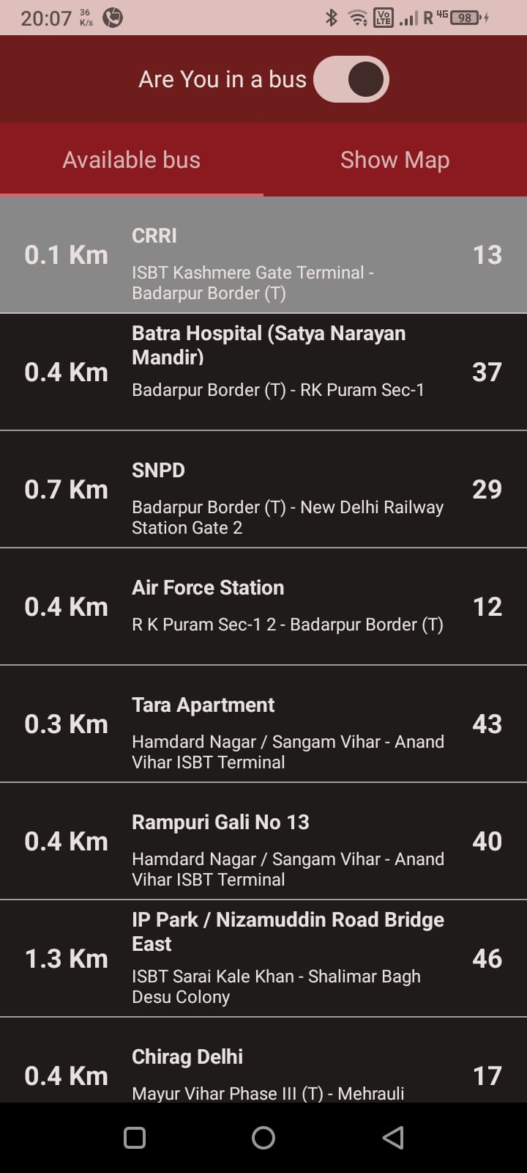
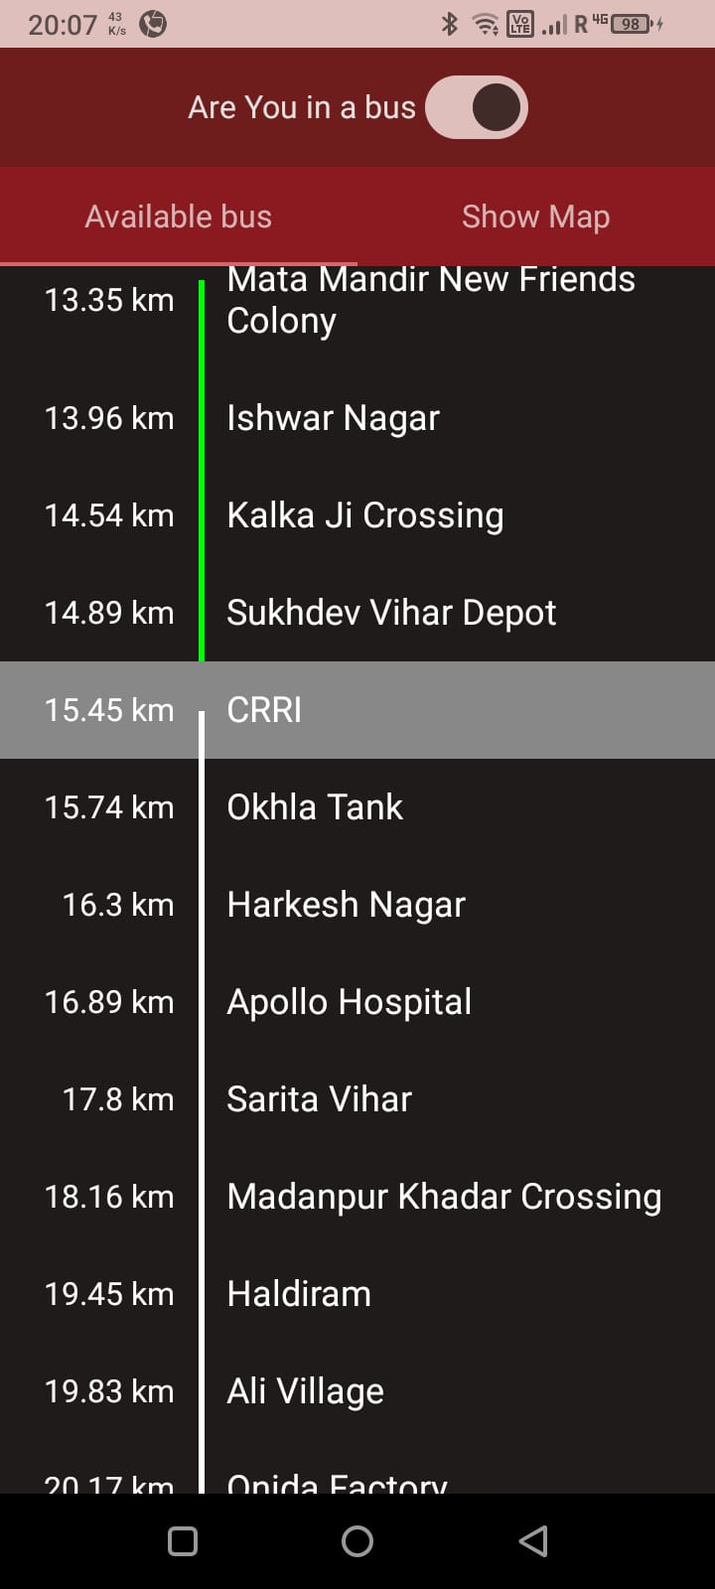
Flow Diagram

Slide 9
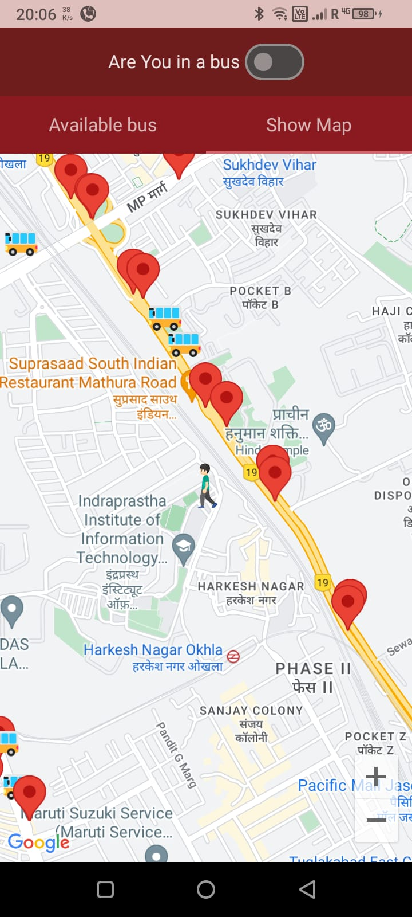
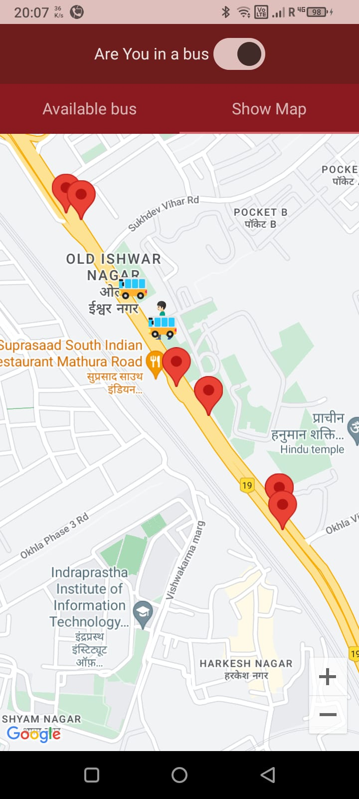
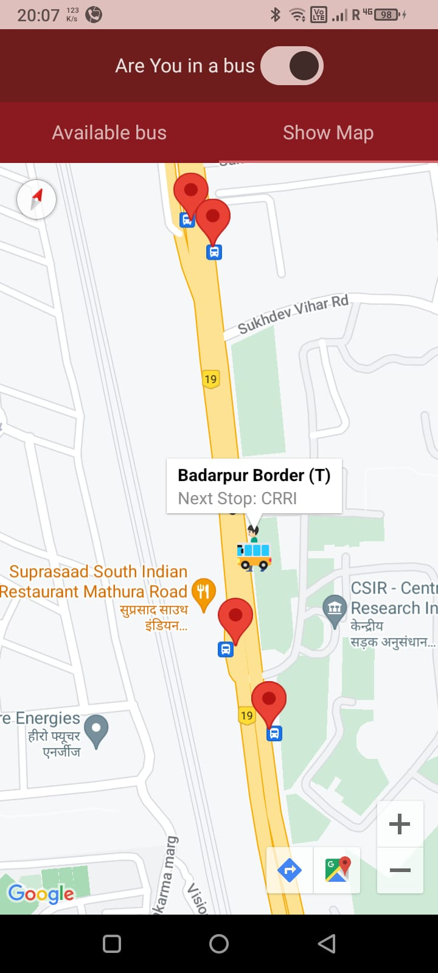



Slide 10






Benefits
Enhanced User Experience:
Our application streamlines the transit experience, providing users with real-time information and intuitive navigation tools. By reducing uncertainty and wait times, it enhances overall satisfaction for commuters.
Optimized Travel Planning:
With access to accurate bus locations and route information, users can plan their journeys more effectively. Whether it's for daily commuting or exploring the city, our application empowers users with timely and reliable transit data.
Improved Urban Mobility:
By promoting the use of public transportation, our solution contributes to reducing traffic congestion and environmental impact. It encourages sustainable mobility practices and fosters a more connected and accessible city.

Slide 11


Conclusion
The Open Transit Bus application represents a significant advancement in urban mobility solutions for Delhi. By harnessing the power of real-time data and intuitive mapping technology, it offers a seamless transit experience for residents and visitors alike. With a focus on convenience, efficiency, and sustainability, our application is poised to transform the way people navigate and experience public transportation in Delhi's dynamic landscape.

Slide 12




Thank you
www.OpenTransit.com

